Slide 1
MODULE 3
Distributed Shared Memory – Algorithms for Implementing Distributed Shared memory – Issues in Load Distributing – Components of Load Distributing Algorithm – Sender- Initiated Algorithm – Receiver- Initiated Algorithm.

Slide 2
Distributed Shared Memory
A resource management component of a distributed operating system that implements shared memory model in distributed systems ,which have no physically shared memory.
A shared memory model provides a virtual address space that is shared among all nodes in a distributed system.
Programs access data in shared address space just as they access data in traditional virtual memory.
Data moves between secondary memory and main memory as well as between main memories of different nodes.

Slide 3
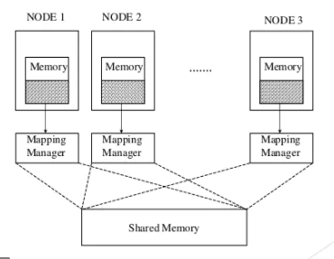
Distributed Shared Memory
A mapping manager maps the shared memory address to the physical memory.
It is a layer of software implemented either in operating system kernel or as a runtime library routine

Slide 4
Algorithms for implementing DSM
The main issues in the implementation of DSM are:
How to keep track of the location of remote data
How to overcome the communication delays and high overhead associated with the execution of protocols while accessing remote data.
How to make shared data concurrently accessible at several nodes in order to improve system performance

Slide 5
Algorithms for implementing DSM
We describe 4 basic algorithms to implement DSM System:
The Central-Server Algorithm
The Migration Algorithm
The Read-Replication Algorithm
The Full Replication Algorithm

Slide 6
The Central-Server Algorithm
A central server maintains all shared data which services the read request from other nodes or clients.
It updates data on write requests and return acknowledgement messages .
A timeout can be implemented to resend request in case of failed acknowledgement.
Duplicate write requests can be detected by associating the sequence numbers with write requests.

Slide 7
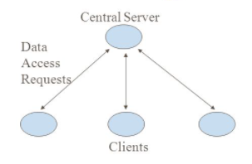
The Central-Server Algorithm
A failure condition is returned to the application after several retransmissions without a response.
Central server can become a bottle neck.
To overcome this problem, shared data can be distributed among several servers.

Slide 8
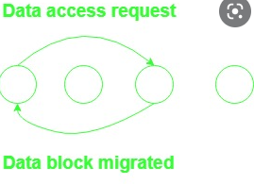
The Migration Algorithm
Data is shipped to the location of data access request, allowing subsequent accesses to the data to be performed locally.
The whole page or block containing the data item migrates.
Allows only one node to access a shared data at a time.
This approach is susceptible to ‘thrashing’ where pages frequently migrate between nodes while servicing only a few requests.

Slide 9
The Migration Algorithm
A tunable parameter has been introduced, that determines the duration for which a node can posses a data item.
To locate data block, a server that keeps track of the location of pages or hints maintained at nodes can be used.

Slide 10
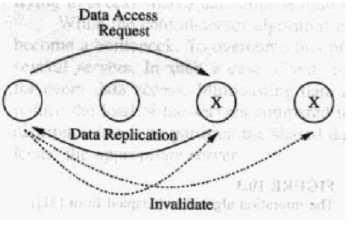
Read Replication Algorithm
Extends migration algorithm, by replicating data blocks.
Allows multiple nodes to have read access, or one node to have read-write access.
Improves system performance due to multiple data access
Write operation is expensive:
1. all copies of a shared block at various nodes have to be invalidated or,
2. all copies should be updated with current value to maintain data consistency.

Slide 11
Read Replication Algorithm
Different approaches are used to keep tack of location of all copies of data block:
Owner node of a data block keeps track of all the nodes that have a copy of the data block.
A distributed linked-list can be used to keep track of all nodes that have a copy of the data block

Slide 12
The full replication algorithm
Extension of read replication algorithm
Allows multiple nodes to have both read and write access to shared data blocks.
Many nodes can write shared data concurrently.
Need to control access to shared data to maintain consistency

Slide 13
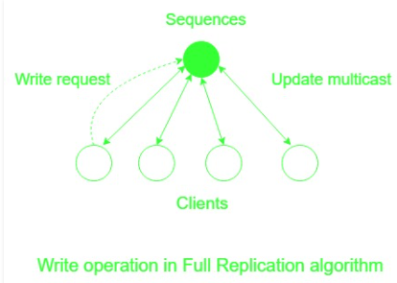
The full replication algorithm

Slide 14
The full replication algorithm
A gap-free sequencer can be used to maintain consistency.
All nodes wishing to modify shared data will send modifications to a sequencer.
Sequencer will assign a sequence number and multicast the modification with the sequence number to all nodes that have a copy of the shared data item.
Each node process the modification requests in sequence number order.
A gap b/w the sequence no: of request and the expected sequence number at node indicates that one or more modifications are missed.
Node will ask for retransmission of modifications it has missed.

Slide 15
LOAD DISTRIBUTION

Slide 16
Issues in Load Distributing- 1. Load
Resource and CPU queue lengths are good indicators of load.
If the task transfer involves large delay then using CPU queue length as load indicator will make the node to accept more tasks while the already accepted task are in transit.
When all the accepted task arrives at the node then the node becomes overloaded and requires further task transfer.
This problem can be solved by artificially incrementing CPU queue length whenever a task is accepted.

Slide 17
Issues in Load Distributing- 1. Load
Little correlation between queue length and CPU utilization for interactive jobs.
So CPU utilization used as load indicator.
Requires a background process that monitors CPU utilization.
It is expensive and imposes more overhead.

Slide 18
Issues in Load Distributing- 2. Classification of Load Distributing Algorithms
Load Distribution Algorithms are classified as static, dynamic or adaptive.
In static algorithms all load distribution decisions are hardwired in an algorithm on the basis of prior knowledge of the system.
Dynamic algorithms make their load distribution decision on the basis of current system state.
They have more scope of improvement as compared to static algorithm.
However the overhead incurred in correcting the system state information may overweigh the load benefit of load distribution

Slide 19
Issues in Load Distributing- 2. Classification of Load Distributing Algorithms
Adaptive Algorithms are a special class of dynamic algorithms and they can adapt their activities by changing the parameter of the algorithm to suite the system state.
For example, at high system load, dynamic algorithms continue the correction of system state information thereby further increasing the system load.
On the other hand, adaptive algorithms will discontinue this procedure.

Slide 20
Issues in Load Distributing- 3. Load Balancing v/s Load Sharing
Load Distribution Algorithms are further classified as load balancing and load sharing.
The main aim of both the algorithms is to reduce the unshared state .
In an unshared state, one computer lies idle while at the same time some other systems are heavily loaded .
Load sharing algorithms transfer tasks to lightly loaded nodes.

Slide 21
Issues in Load Distributing- 3. Load Balancing v/s Load Sharing
Load Balancing algorithms goes one step ahead by equally distributing the load on all computers.
Load balancing algorithms have higher overhead when compared to load sharing algorithms
Anticipatory task transfers can reduce the duration of unshared state.

Slide 22
Issues in Load Distributing- 4. Preemptive vs.Nonpreemptive Transfers
Pre-emptive task transfer that involves transfer of a tasks that is partially executed.
This transfer is an expensive operation, as the collection of a task’s state can be difficult.
A task state may consists of Vitrual Memory image, PCB, unread I/O buffers, file pointers etc.
Non-preemptive tasks transfer involves those tasks which have not begin their execution.
So we don’t have to transfer the task’s state.

Slide 23
Issues in Load Distributing- 4. Preemptive vs.Nonpreemptive Transfers
In both type of task transfer, the environment in which the tasks will execute must be transferred to the receiving node.
This information may include user’s current working directory, the privileges inherited by the task etc.
Non preemptive task transfers are also referred to as task placements

Slide 24
Components of Load Distributing Algorithm
A load distribution algorithm has four components:
Transfer policy
Selection policy
Location policy
Information policy

Slide 25
1.Transfer Policy
Transfer policy indicates when a node (system) is in a suitable state to participate in a task transfer.
The most popular proposed concept for transfer policy is based on a optimum threshold.
When a new task originates in a particular node and the load at the node goes beyond the threshold T, the node becomes a sender.
When the load at a particular node falls bellow T, transfer policy decides that the node can be a receiver for a remote task.

Slide 26
2.Selection Policy
Selection policy determines which task in the node (selected by the transfer policy), should be transferred.
If the selection policy fails to find a suitable task in the node, then the transfer procedure is stopped until the transfer policy indicates that the site is again a sender.
Simplest approach is to select the newly originated task that has caused the node to be a sender for transfer, as the transfer is non pre-emptive.
The overhead incurred in the transfer of task should be compensated for by the reduction in the response time realised by the task

Slide 27
2.Selection Policy
In another approach, task can be selected for transfer if its response time will be improved upon transfer.
There are other factors to consider in the selection of a task
The overhead incurred by the transfer should be minimal (a task of small size carries less overhead
The number of location dependent system calls made by the selected task should be minimal.

Slide 28
3.Location Policy
Location policy determines, to which node, a task selected for transfer should be send.
A widely used method to find suitable node is polling.
In polling, a node polls another node to find out whether it is a suitable node for load sharing.
A node can be selected for polling either randomly based on the information collected during the previous polls, or on a nearest neighbour basis.
An alternative to polling is to broadcast a query to find out if any node is available for sharing.

Slide 29
4. Information Policy
Responsible for deciding
When information about states of other nodes in the system should be collected,
where it should be collected from
What information should be collected
There are mainly 3 types of information policies:
Demand Driven
Periodic
State Change Driven

Slide 30
4. Information Policy
Demand Driven
A node collects states of other nodes only when it becomes either a sender or receiver.
Dynamic policy as its actions depend on the system state.
Can be sender initiated, receiver initiated or Symmetrically initiated
In sender initiated policies ,the senders look for receivers to transfer their load
In receiver initiated policies, receivers solicit load from senders.
A symmetrically initiated policy is a combination of both, where load sharing actions are triggered by the demand for extra processing power or extra work

Slide 31
4. Information Policy
Periodic
Nodes exchange load information periodically.
Based on collected information, transfer policy at a node may decide to transfer jobs.
Don’t adapt their activity to the system state.
In high load systems, periodic information collection will increase the system load and thus worsen the situation

Slide 32
4. Information Policy
State Change Driven
Nodes disseminate state information whenever their state changes by a certain degree,
Under centralized state-change driven policies, nodes send information to a centralized collection point.
Under decentralized state-change driven policies, nodes send information to peers.

Slide 33
Load Distributing Algorithms
Sender Initiated Algorithms:
Load distribution Activity is initiated by an overloaded node that attempts to send a task to an under loaded node.
There are 3 commonly used algorithms:
Random
Threshold
Shortest

Slide 34
Sender Initiated Algorithms
All the three algorithms use the same transfer policy, a threshold policy based on CPU queue length.
These algorithms uses same selection policy where, it considers only newly arrived tasks for transfer.
These algorithms differ only in their location policy.

Slide 35
Sender Initiated Algorithms: Random
A task is simply transferred to a node selected at random with no information exchange b/w nodes .
Drawback is that useless task transfer can occur when a task is transferred to a node that is heavily loaded.
If the transferred task is treated as new arrival, the task can be again transferred to another node, if the local queue length is above the threshold.
The system may enter a state where entire time may be spend to transfer task, not executing them.(which is solved by limiting no: of transfers).
A sender initiated algorithm with random policy provides substantial performance over no load sharing.

Slide 36
Sender Initiated Algorithms: Threshold
Useless task transfer in random policy can be avoided by polling a node to determine whether it is a receiver.
If so task is transferred to the selected node, which must execute the task.
Otherwise another node is polled and no: of polls is limited by a parameter called Poll Limit.
If no suitable receiver node is found within pollLimits, then the node at which task originated must execute the task.
Provides better performance when compared to random location policy.

Slide 37
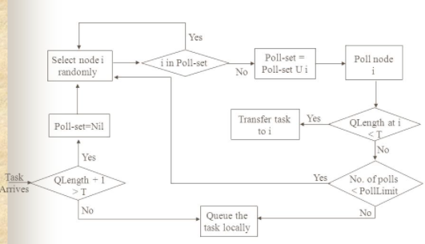
Sender Initiated Algorithms: Threshold

Slide 38
Sender Initiated Algorithms: Shortest
Certain no: of nodes(=poll limit) are selected at random and are polled to determine their queue length.
Node with shortest queue length is selected as destination for task transfer, unless its queue length>=T.
The destination node will execute the task regardless of its queue length at the time of arrival of transferred task.
The performance improvement obtained by using shortest location policy is marginal when compared with threshold policy.

Slide 39
Sender Initiated Algorithms: Information Policy & Stability
In shortest or threshold location policy, polling activity commences when a sender node is identified.
So Information policy is demand driven.
All the three approaches for location policy can cause system instability at high system loads.
The probability of finding a receiver node is very low and CPU cycles are wasted in unsuccessful polls to find receiver node.

Slide 40
Receiver Initiated Algorithms
Load distributing activity is initiate from an under loaded node that is trying to obtain a task from an overloaded node(sender).
The policies of algorithm are:
Transfer policy:
If local queue length falls below threshold ,it acts as a receiver to obtain task from a sender which is determined by location policy.
A node is sender, if the queue length exceeds threshold.
Selection Policy:
Algorithm can follow any of the approaches specified in selection policy

Slide 41
Receiver Initiated Algorithms
Location Policy
Node is selected at random and polled to determine if transferring a task from it would place its queue length below threshold level.
If not the task is transferred .Otherwise another node is selected randomly and the procedure is repeated.
If polls fail to find a sender, node waits until another task completes or a predetermined period is over to initiate the search for a sender.
If the search doesn’t start after the predetermined time, extra processing power at receiver will be unutitlized.

Slide 42
Receiver Initiated Algorithms:
Information Policy
Demand driven, because polling activity starts only after a node becomes a receiver.
Stability
Receiver initiated algorithms doesn’t cause instability as during high system loads there is a high probability that receiver will find a suitable sender to share the load within few polls.
During low system loads, there will be few senders and more receivers.
These polls do not cause system instability as there are spare CPU cycles available at low system loads.

Slide 43
Receiver Initiated Algorithms: Draw backs
In receiver initiated algorithms, polling starts when a node becomes a receiver.
But its unlikely that these polls will be received at senders when new tasks that have arrived at them haven’t begun executing.
So most transfers are pre-emptive and there for expensive

